Slide 1
Analyse pattern for loan default

Slide 2
Introduction:
Problem Statement: Identify patterns which indicate if a person is likely to default, which may be used for taking actions such as denying the loan, reducing the amount of loan, lending (to risky applicants) at a higher interest rate, etc.
Analysis Approach: Utilizing exploratory data analysis (EDA) techniques to uncover patterns and insights from loan data.

Slide 3
Univariate Analysis Insights:
1. Loan Status:
About 86% of the loans in our dataset have been fully paid, while only 14% have been charged off or defaulted. This indicates that the majority of customers are responsible borrowers who fulfill their loan obligations.
2. Loan Issue Year:
The number of loans issued has grown steadily over the years, with a peak in 2011. This suggests that our lending business has been expanding and attracting more customers each year.
3. Grade:
Customers with better credit grades (e.g., A and B) are more likely to take loans. This means that higher-grade employees are more confident in their ability to repay loans, making them more attractive prospects for our lending services.
4. Loan Purpose:
Debt consolidation is the primary reason for customers taking out loans, followed by other purposes like home improvement and major purchases. This insight helps us tailor our marketing and lending strategies based on the most popular loan purposes.

Slide 4
Univariate Analysis Insights [Contd.]:
5. Employee Experience:
Both new and experienced employees tend to borrow more frequently. This suggests that our lending services cater to a broad range of employees across different career stages.
6. Loan Amount:
We notice that loans with amounts around 5000 are most common, indicating that customers often borrow for medium-sized expenses.
7. Interest Rate:
Interest rates tend to cluster around specific values, such as 7.5% and 12%. This information is crucial for our pricing strategy, ensuring that our rates remain competitive.
8. Loan Term and Purpose:
Short-term loans are the preferred choice for debt consolidation, while other purposes tend to opt for long-term loans. Aligning loan terms with customer needs can improve repayment rates.

Slide 5
Bivariate Analysis Insights:
1. Interest Rates and Loan Status:
Fully paid loans have lower mean interest rates compared to charged off loans.
2. Annual Income and Loan Status:
Higher mean annual income corresponds to fully paid loans, indicating income's impact on repayment behavior.
3. Grade and Loan Status:
Loan grade influences repayment, with better grades leading to higher chances of full repayment.
4. Loan Amount and Default Behavior:
Smaller loan amounts tend to have a higher likelihood of full repayment.

Slide 6
Bivariate Analysis Insights [Contd.]:
5. Loan Term Impact:
Long-term loans are more likely to result in defaults, emphasizing the importance of assessing term-based risks.
6. Loan Purpose and Default Rates:
Certain loan purposes, such as small business and renewable energy, have higher default rates.

Slide 7
Recommendations:
1. Implement risk assessment strategies based on borrower attributes like grade and annual income.
2. Tailor loan offerings based on loan purpose to minimize default risk.
3. Offer smaller loan amounts for higher repayment certainty.
4. Monitor interest rates and offer competitive rates to encourage prompt repayment.
5. Carefully evaluate long-term loan applications to minimize default risks.
6. Utilize predictive models for proactive risk management and continuous improvement.

Slide 8
Conclusion:
1. Risk Assessment and Borrower Profiles:
Borrowers with higher annual incomes are generally more creditworthy and have a better repayment capacity.
Loan grades play a significant role in predicting loan default. Borrowers with higher-grade loans tend to have better repayment behavior.
2. Loan Amount and Default Behavior:
Smaller loan amounts have a higher likelihood of being fully paid, while larger loan amounts are associated with a higher risk of default.
3. Interest Rates and Repayment:
Interest rates impact loan repayment behavior. Lower interest rates are correlated with higher rates of full repayment.
4. Loan Purpose and Default Rates:
Certain loan purposes, such as small business and renewable energy, have higher default rates. Understanding the relationship between loan purpose and repayment behavior can inform risk assessment strategies.

Slide 9
Conclusion [Contd.]:
5. Loan Term Impact:
Long-term loans are more likely to result in defaults compared to short-term loans. This suggests that customers may face challenges repaying loans over extended periods.
6. Grade-Based Strategies:
A careful assessment of borrower grades is crucial. Lower-grade loans should undergo rigorous evaluation, and risk management strategies should be adapted accordingly.
7. Customer Segmentation:
Using attributes like annual income and loan grade, customers can be segmented into risk profiles. This allows for tailored loan offerings and more effective risk assessment.

Slide 10
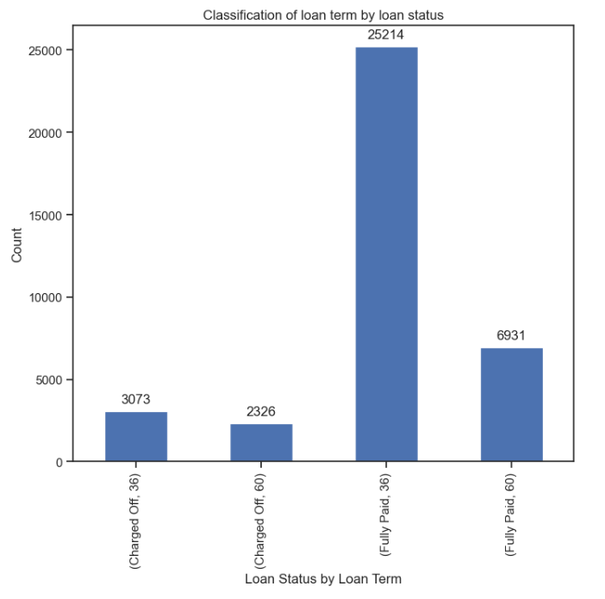
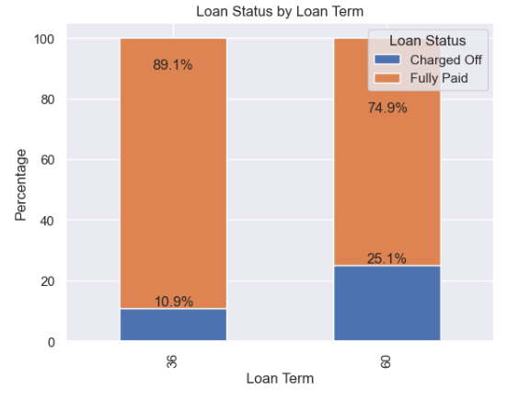
Visualizations:
Although the count of short-term loans taken is three times higher than that of long-term loans, it is noteworthy that long-term loans are twice as prone to being charged off compared to short-term loans. Specifically, while 11% of short-term loans face default, a significantly higher proportion of 25% of long-term loans experience the same outcome.

Slide 11
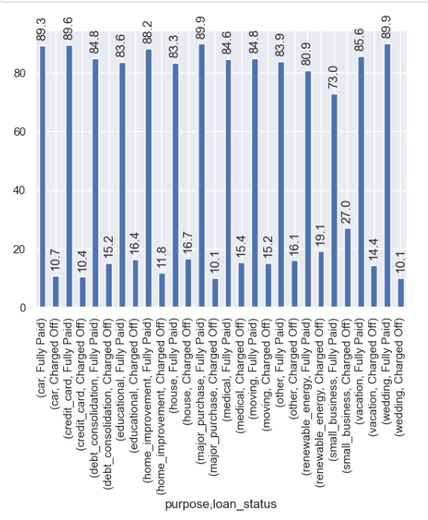
Visualizations [Contd.]:
Loans taken for small business are the most charged off.
27% of small business loans and
19% of renewable energy loans
are charged off.
Only 10% of loans are charged off for car,
credit card, major purchase,
home improvement and wedding.
Loans taken for the remaining purposes are
charged off around 15% on average.

Slide 12
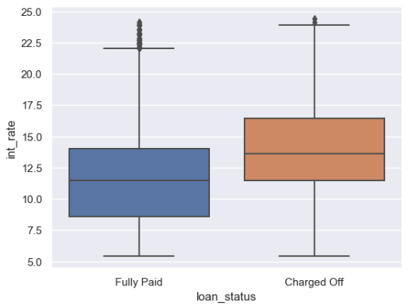
Visualizations [Contd.]:
On average, charged-off loans tend to have higher interest rates compared to fully paid loans.

Slide 13
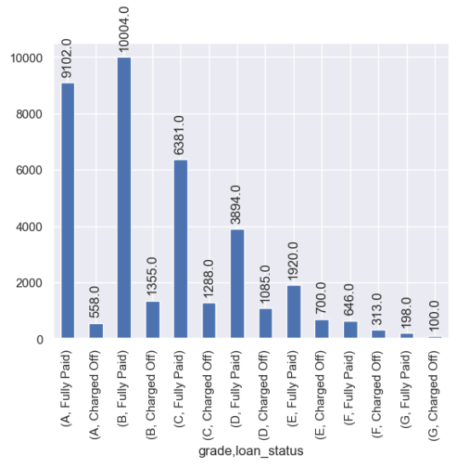
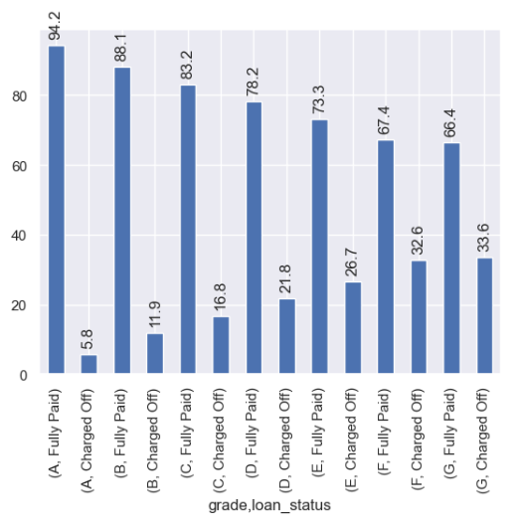
Visualizations [Contd.]:
Grade G exhibits the highest percentage of charged-off loans, despite being the least represented group in terms of loan uptake among all the grades.

Slide 14
Thank You!

